Slide 1

Bruce-Grey Catholic District
School Board
Accommodation Plans
French Immersion Program Expand Possibility Analysis
Course: GEO 641
Profersor: Emily Hazell
PRESENTED BY SIGAO LI

Slide 2
RESEARCH BACKGROUNDS
1
CONTENTS
RESEARCH METHODS
2
ANALYSIS AND DISCUSSION
3
CONCLUSION AND SUGGESTION
4
REFERENCES
5

Slide 3
1
RESEARCH BACKGROUNDS

Slide 4
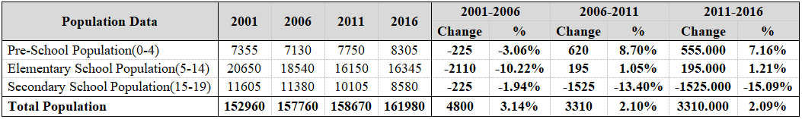
1
RESEARCH BACKGROUNDS
Note: Adapted from Statistics Canada, CHASS

Slide 5
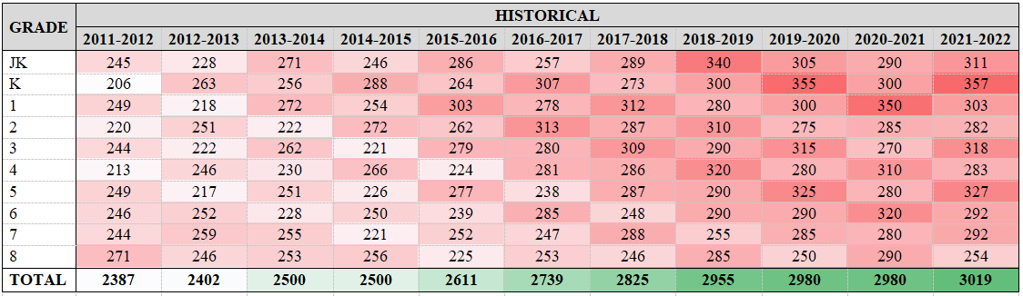
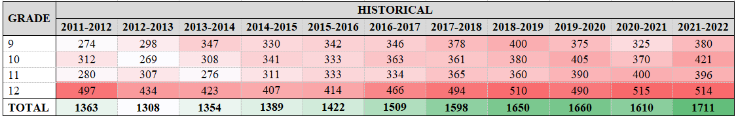
1
RESEARCH BACKGROUNDS
Note: Adapted from Open Data Ontario

Slide 6
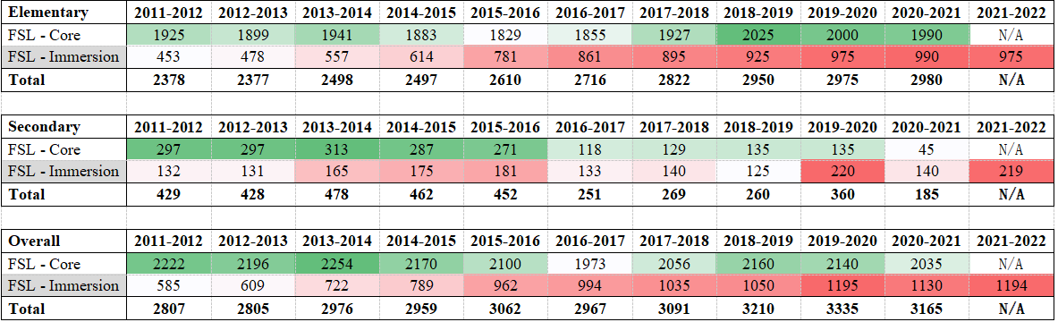
1
RESEARCH BACKGROUNDS
Note: Adapted from Open Data Ontario

Slide 7
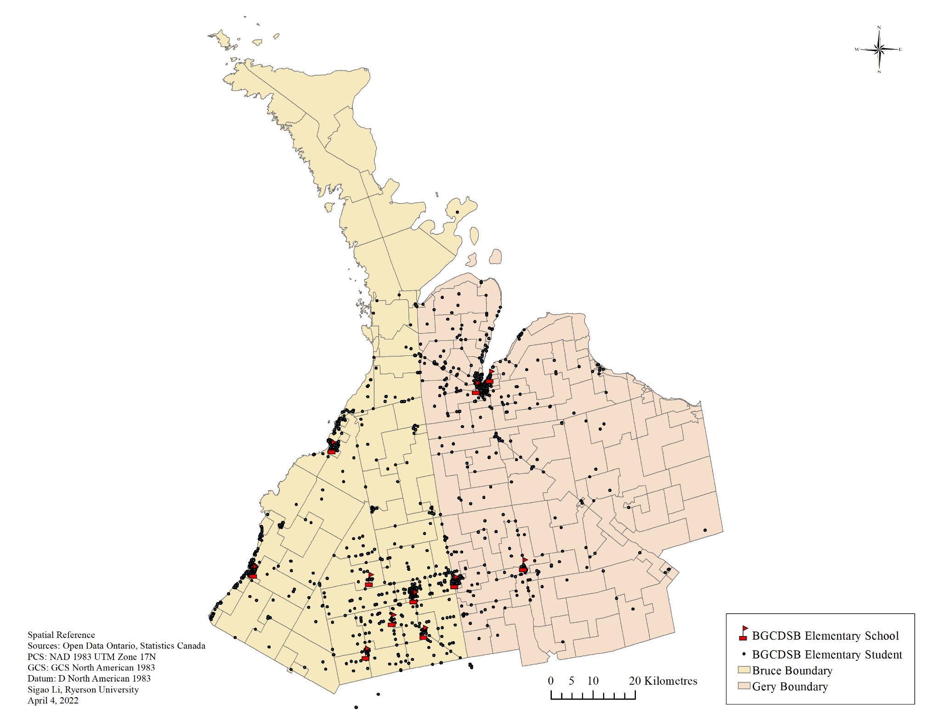
1
RESEARCH BACKGROUNDS

Slide 8
2
RESEARCH METHODS

Slide 9
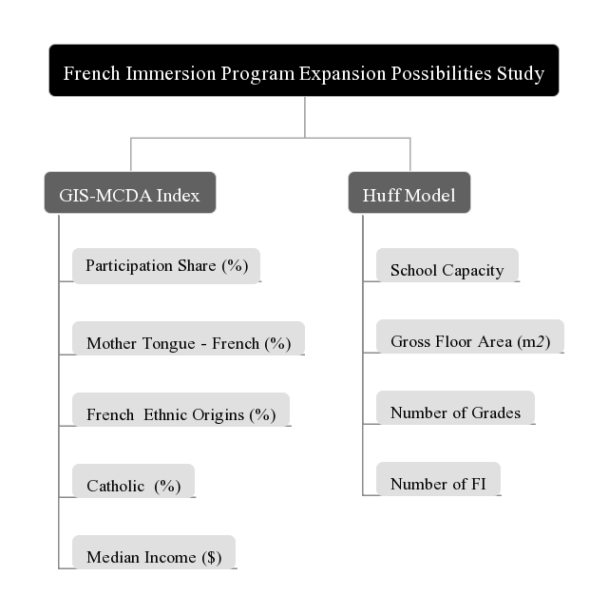
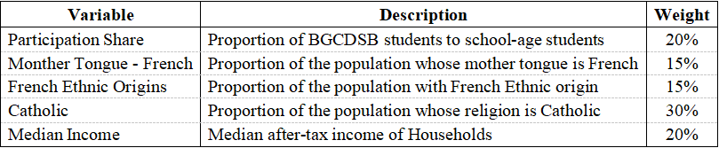
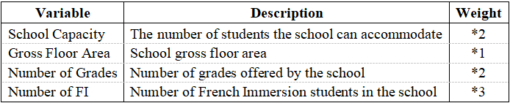
2
RESEARCH METHODS

Slide 10
3
ANALYSIS AND DISCUSSION

Slide 11
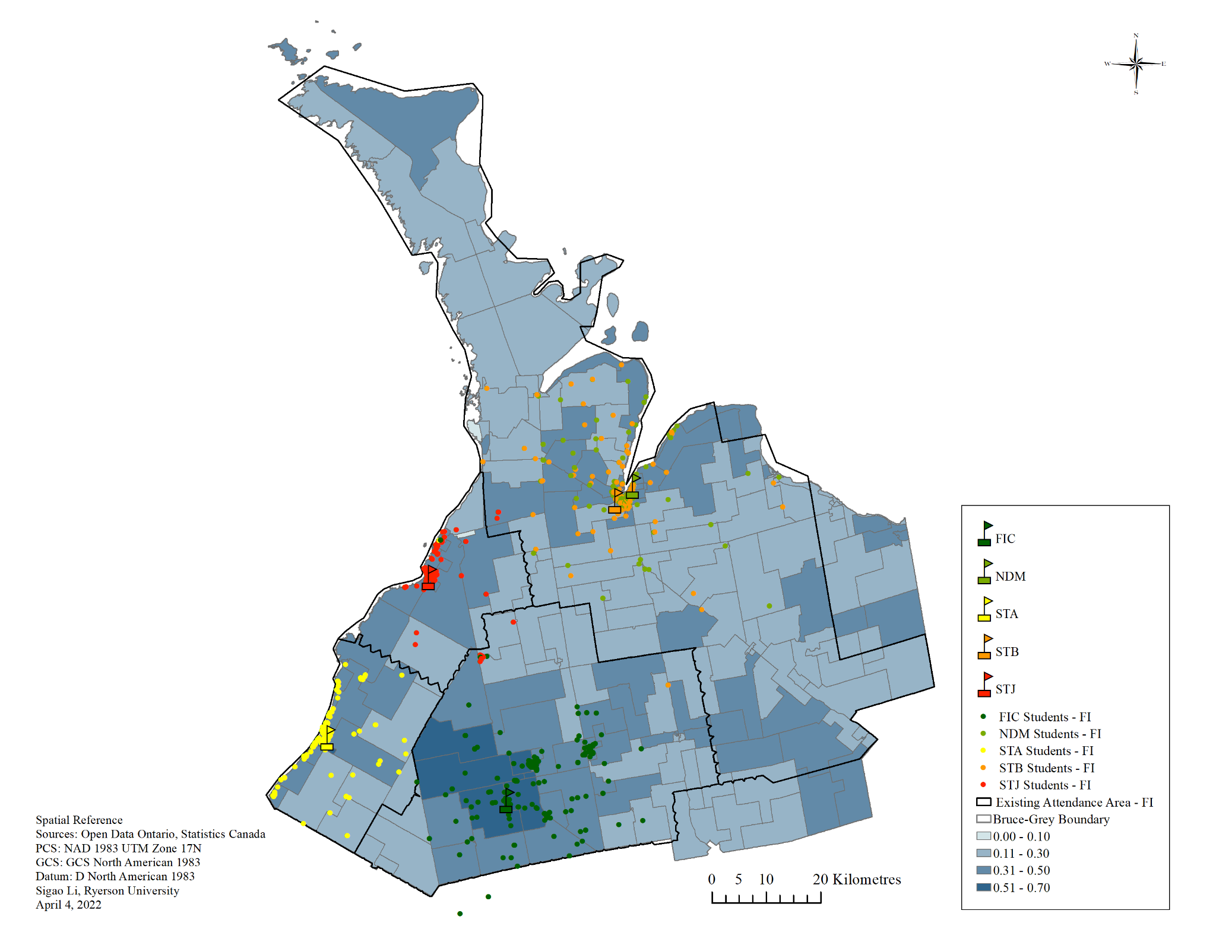
3
ANALYSIS AND DISCUSSION

Slide 12
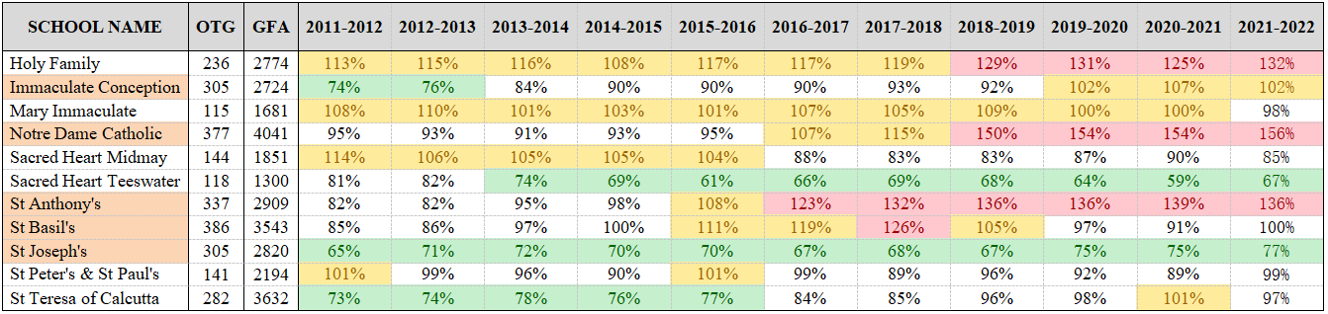
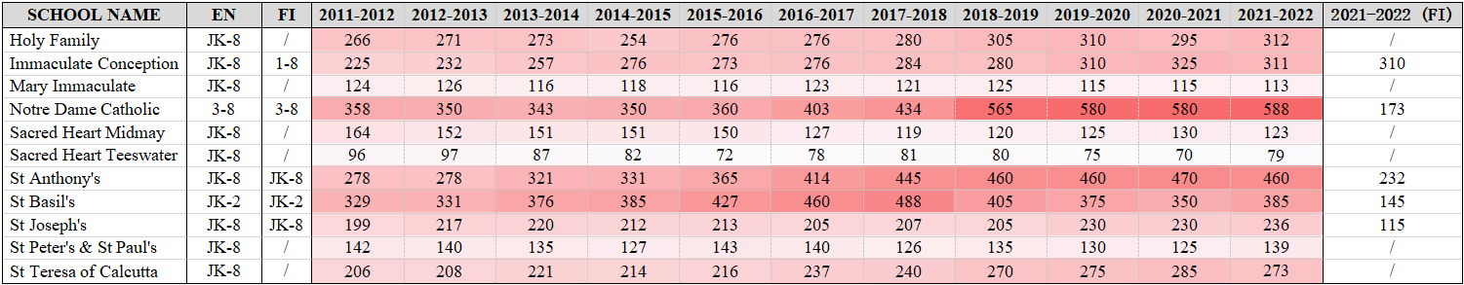
3
ANALYSIS AND DISCUSSION
Note: Adapted from Open Data Ontario

Slide 13
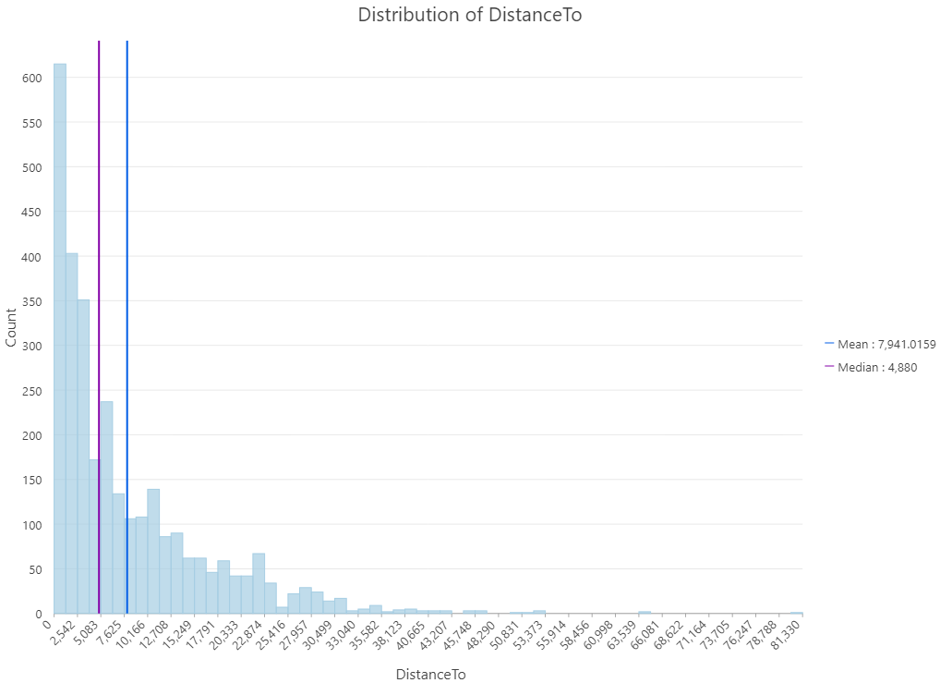
3
ANALYSIS AND DISCUSSION

Slide 14
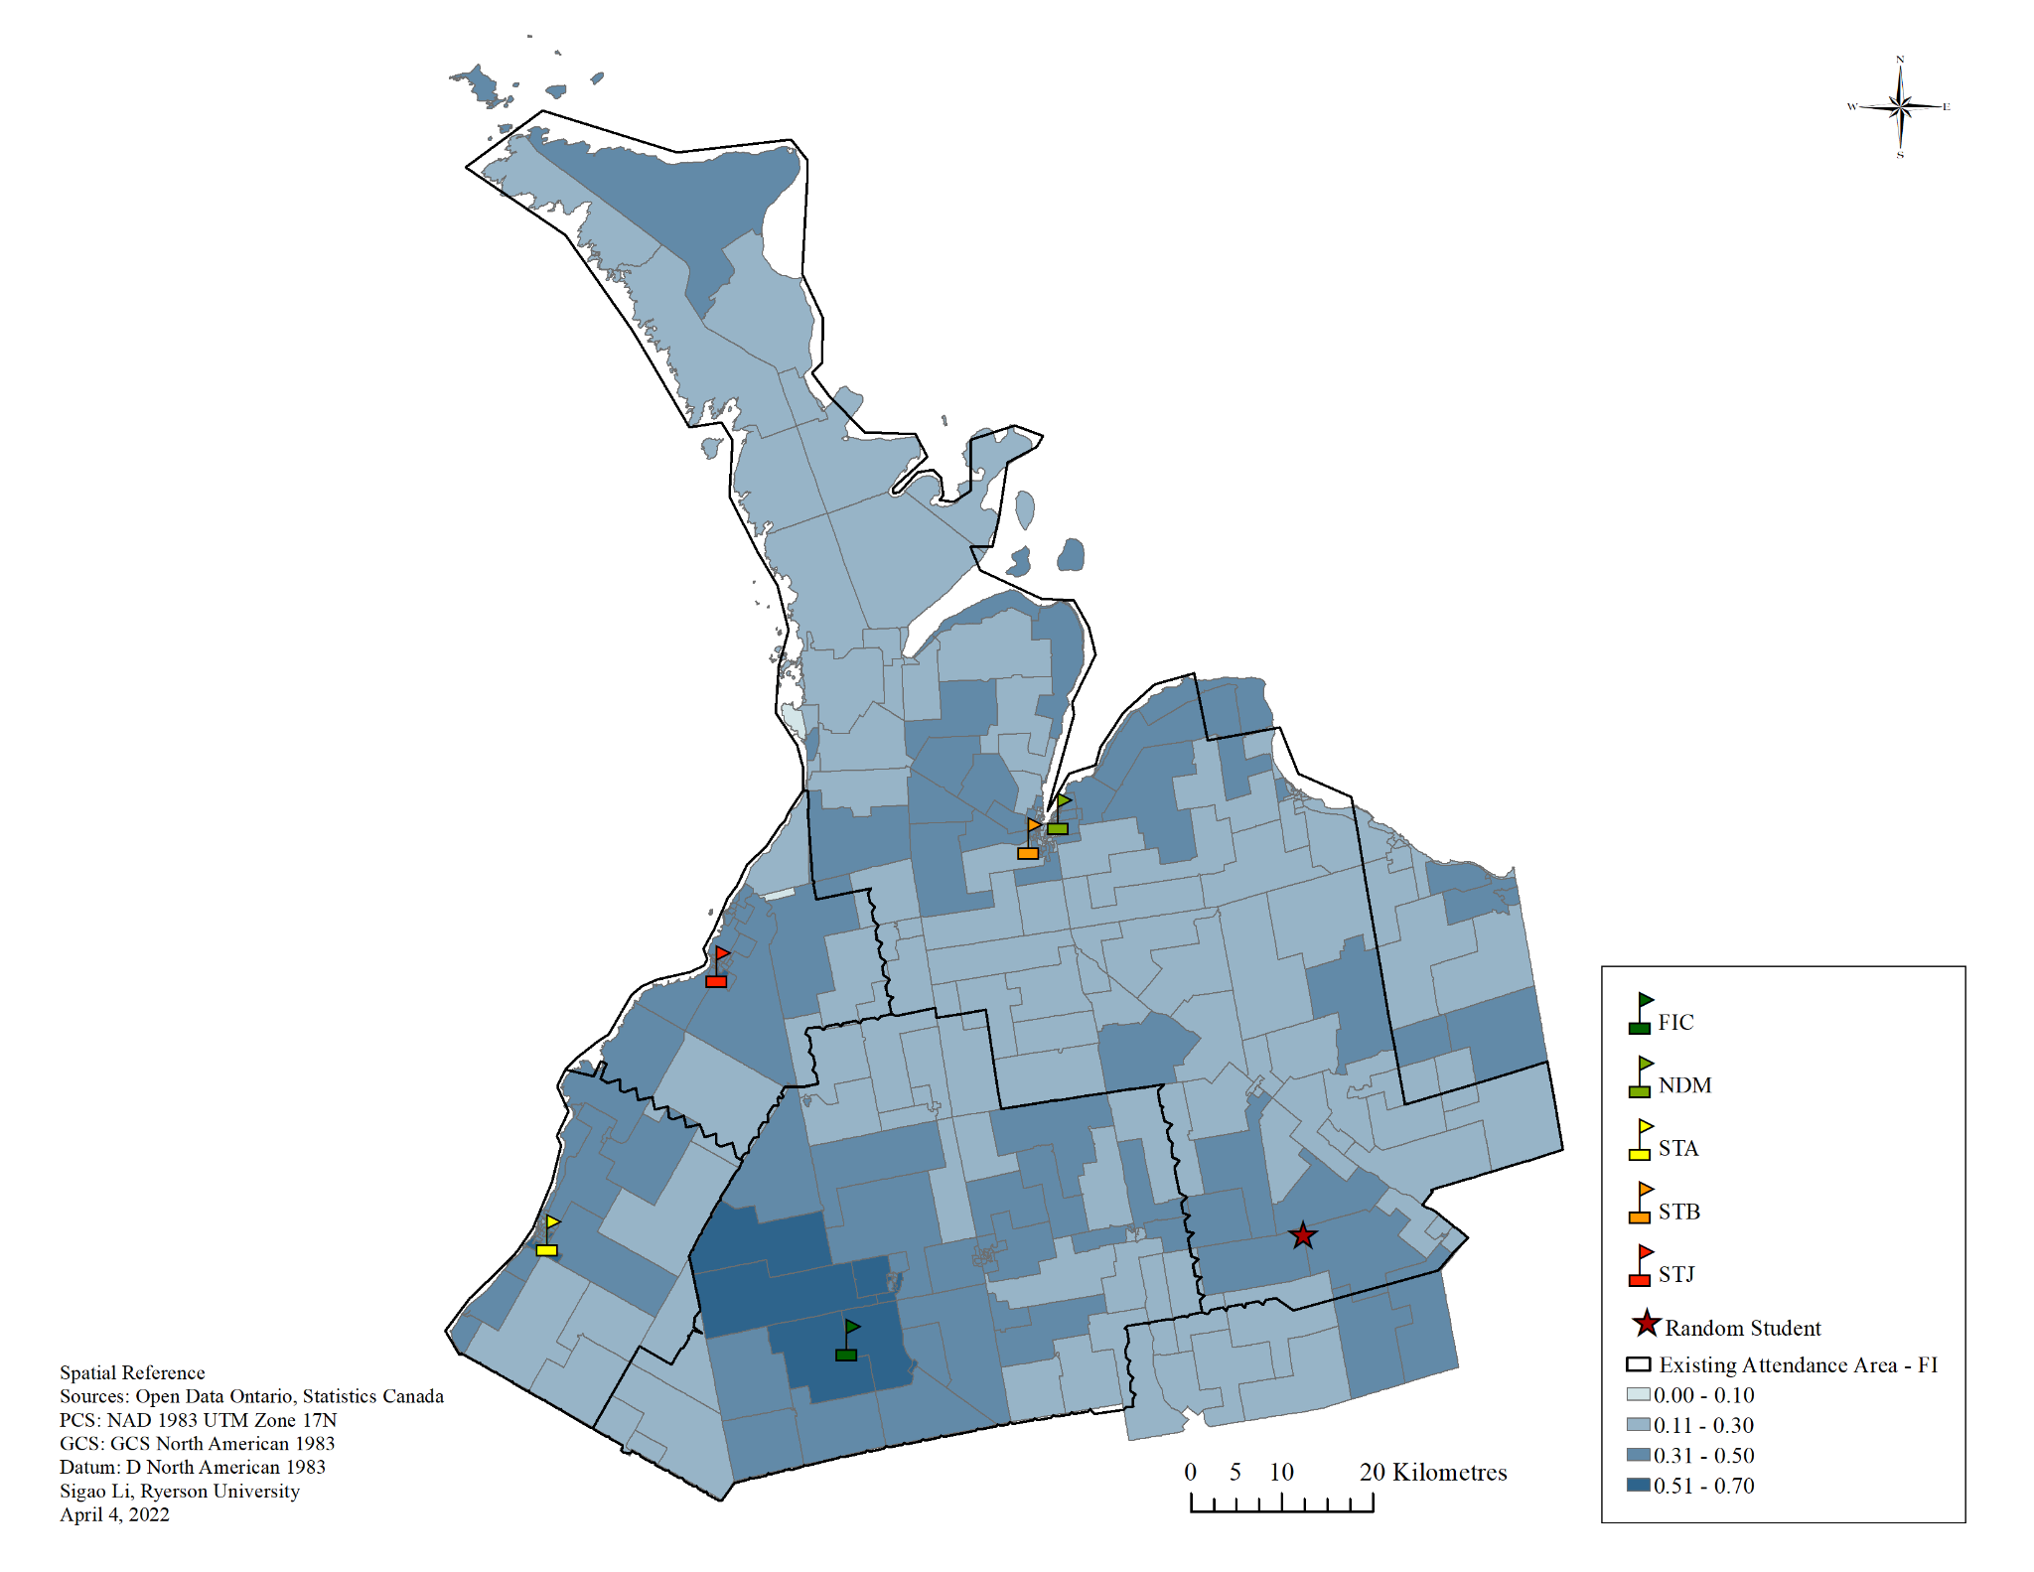
3
ANALYSIS AND DISCUSSION

Slide 15
3
ANALYSIS AND DISCUSSION
Note: Adapted from Open Data Ontario

Slide 16
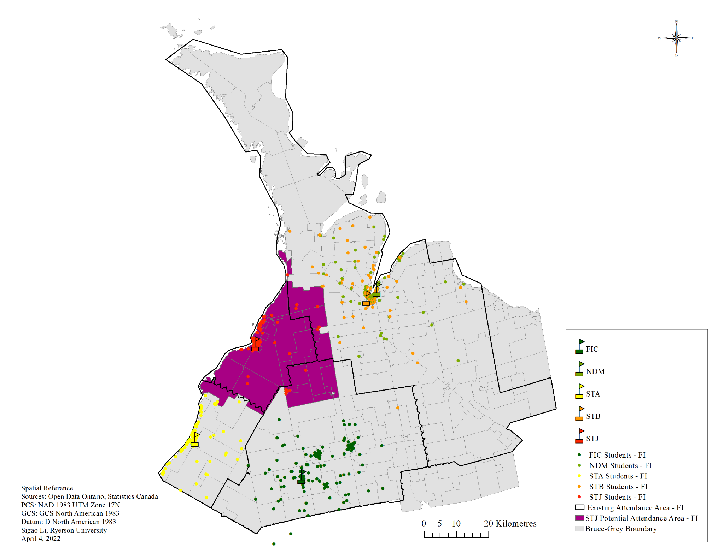
3
ANALYSIS AND DISCUSSION

Slide 17
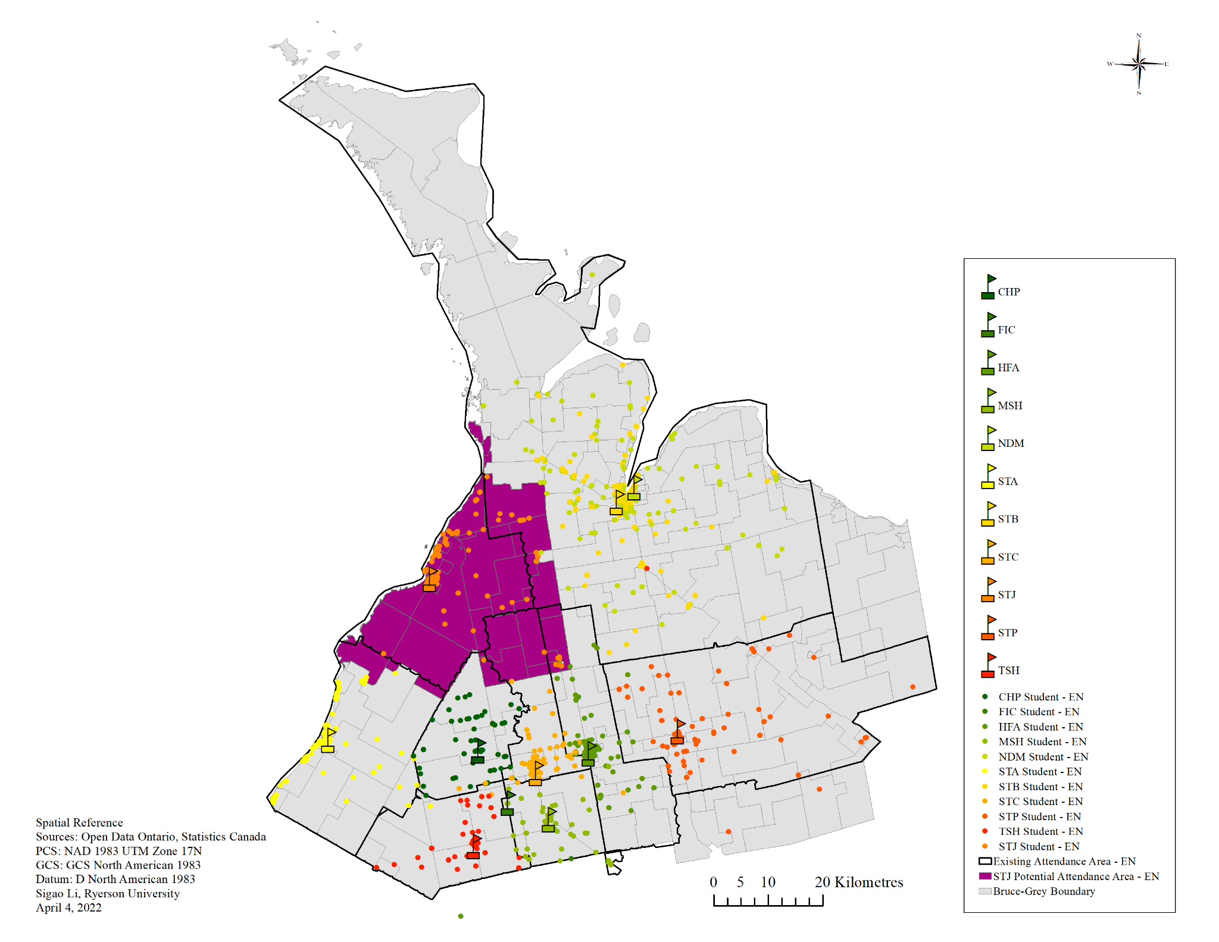
3
ANALYSIS AND DISCUSSION

Slide 18
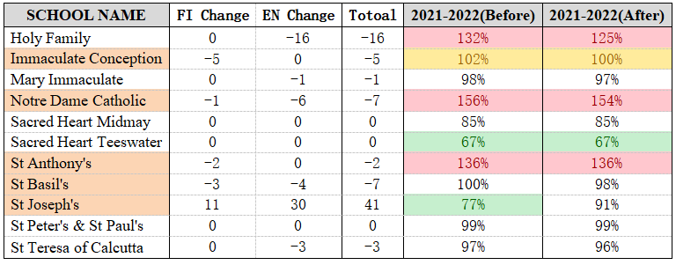
3
ANALYSIS AND DISCUSSION
Note: Adapted from Open Data Ontario

Slide 19

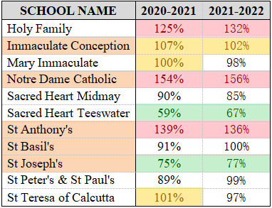
3
ANALYSIS AND DISCUSSION

Slide 20
4
CONCLUSION AND SUGGESTIONS

Slide 21
4
CONCLUSION AND SUGGESTIONS
1. Minimum expenditures (change attendance boundary)
· Enrollment pressure in some schools can be improved, maximizing the use of existing resources.
2. Certain expenditures (refurbishment and expansion)
· FIC, NDM and STA desperately need more capacity.
· HFA or STP can expand FI to meet future FI admission needs from nearby areas.
3. Larger expenditures (build new schools)
· In the eastern region, dual-track elementary schools that also provide FI can be built. There is a high probability that it will attract students who want to enroll in FI but give up due to distance issues, as well as some students who may have enrolled in FI programs in other districts (public schools) in the area.

Slide 22
5
References

Slide 23
5
References
· CHASS. (2022). Canadian Census Analyser. Retrieved from: http://dc2.chass.utoronto.ca.ezproxy.lib.ryerson.ca/census/
· Open Data Ontario. (2022). Enrolment by grade in elementary schools. Retrieved from: https://data.ontario.ca/en/dataset/enrolment-by-grade-in-elementary-schools
· Open Data Ontario. (2022). Enrolment by grade in secondary schools. Retrieved from: https://data.ontario.ca/en/dataset/enrolment-by-grade-in-secondary-schools
· Open Data Ontario. (2022). Elementary class size. Retrieved from: https://data.ontario.ca/en/dataset/elementary-class-size
· Open Data Ontario. (2022). French as a Second Language enrolment. Retrieved from: https://data.ontario.ca/en/dataset/french-as-a-second-language-enrolment
· Open Data Ontario. (2022). Ontario public schools enrolment. Retrieved from: https://data.ontario.ca/en/dataset/ontario-public-schools-enrolment

Slide 24
Thank YOU FOR WATCHING

